Slide 1

CHAPTER 3:
FAST.FOOD BLUES:
WORK IN A GLOBAL
ECONOMY

Slide 2
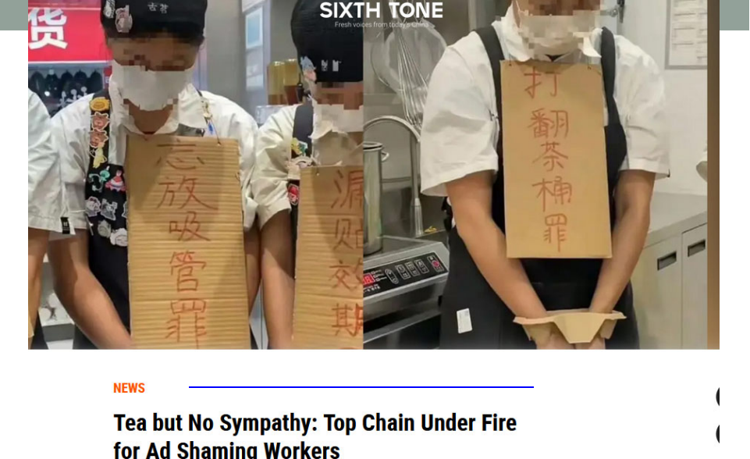
https://www.sixthtone.com/news/1015907
Around their necks hang signs scrawled with offenses like “failing to add nuts,” “forgetting to include a straw,” and “forgetting to put on a lid” — alongside the words “I am guilty” in Chinese.

Slide 3
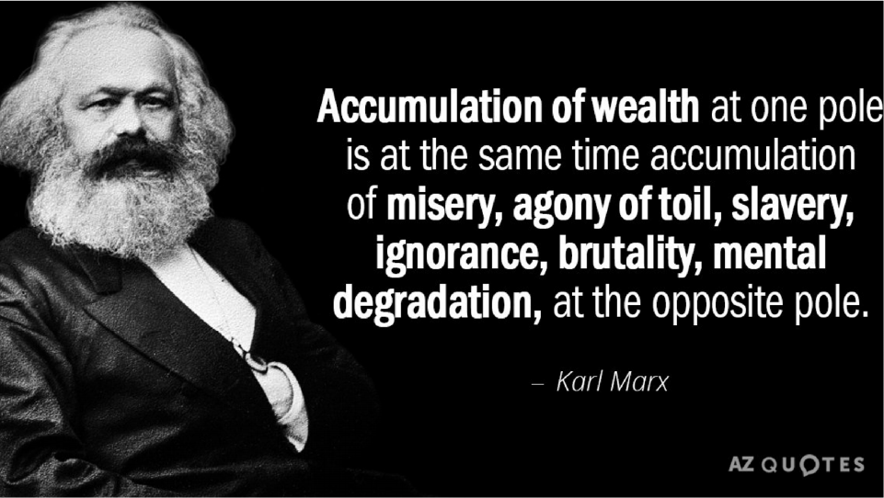

Slide 4
Class
People with similar levels of income, wealth, education, occupational prestige, lifestyle,
social status and/or access to material goods and services.
Marx: classes in capitalism:
1. Workers (the proletariat) and
2. Owners of the means of production (the bourgeoisie). • Which of these two classes do you belong to? How can you tell?
• Are there any other classes in capitalism? If there are, what is their relationship to these two classes?
© 2017 Taylor & Francis

Slide 5
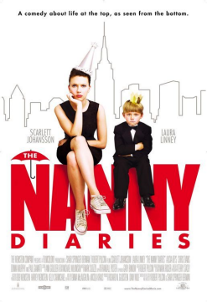
Wage labor
A relationship in which a worker sells
his or her labor to an employer.
A norm in capitalism.
Labor is also a source of personal meaning.
• What is your dream job?
• If you had to choose, would you choose a well-paid job or a personally satisfying one?
© 2017 Taylor & Francis

Slide 6
“The Young Chinese Working as On- Demand Private Chefs … .”
https://www.sixthtone.com/news/1013804
DO YOU THINK THAT THIS IS A
DESIRABLE JOB?
• Have you ever been employed?
• Have you been employed because you wanted to work or because you had to?
• What has been satisfying and what has been dissatisfying about your work?

Slide 7
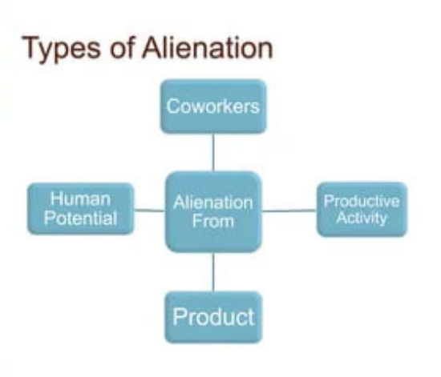
Alienation—definition
A feeling of
estrangement
often associated
with work in
capitalism.
© 2017 Taylor & Francis

Slide 8
Aspects of alienation
1. Alienation from the work process: lack of control over it;
• Have you ever thought that you could organize the work process better than your boss had?
2. Alienation from the product of work: lack of control over them and the profit derived from them;
• Can BMW workers afford BMWs?
3. Alienation from other workers; and
• Why is there back-stabbing at work?
4. Alienation from workers’ own nature as creative beings. • Have you ever been bored at work?
© 2017 Taylor & Francis

Slide 9
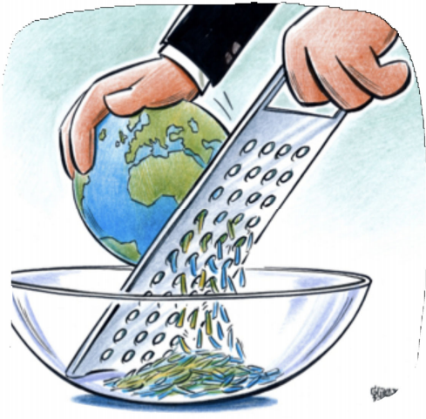
Transnational corporations (TNCs)
Business enterprises that span national boundaries.
Influential actors in the global
economy.
• Three companies control most of the frozen French fries in the world. Do you know any of them?
• Do you know what a “banana republic” is? Why is it called that?
© 2017 Taylor & Francis

Slide 10
Global mobility of capital and labor
Continued importance of national borders in a globalized economy: regulation of migration and labor conditions.
Transnational capitalists move easily across national borders and have many similarities.
International workers are less mobile, more divided, and
more vulnerable than capitalists.
• What do you know about work and life of undocumented workers in your country?
• Are there such people as “undocumented capitalists”? Why?
© 2017 Taylor & Francis

Slide 11
Shift toward “McJobs”
Most newly generated jobs are unskilled and low-wage “McJobs,” and not highly-skilled “knowledge” jobs.
Factors: a structural shift toward services, increased
international competition, outsourcing of labor overseas, part- time and temporary employment, decline in the power of
unions.
• Where – beside “McDonald’s” – do you find “McJobs”?
• How can you tell which job advertisements are for “McJobs”?
• Look up employment opportunities at your local “Craig’s List” or “Kijiji” and calculate the percentage of “McJobs.”
© 2017 Taylor & Francis

Slide 12
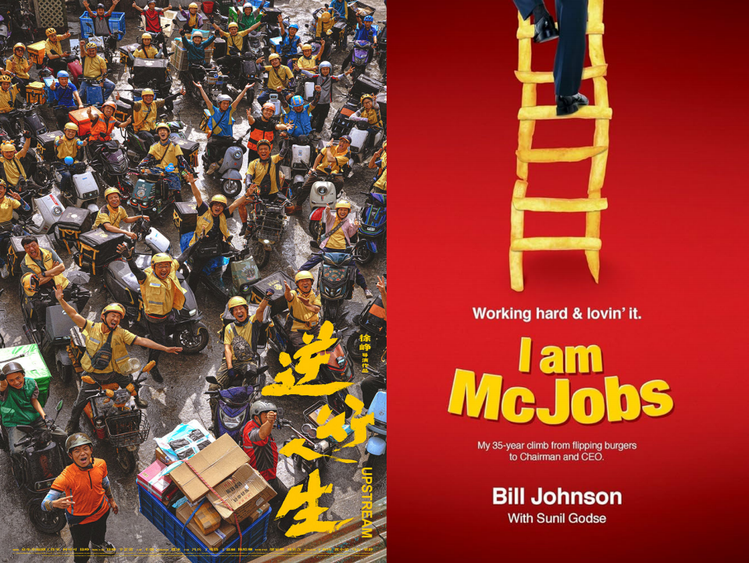

Slide 13
Commodity chains
The path a commodity takes from its conception and design, through manufacturing, retailing and
consumption, to its end as waste.
• Is it true or not that “everything is made in China”?
• Where were your clothes made?
• Where was fresh produce in your fridge and pantry grown?
• How did they get to you?
• If both the overseas and the local produce are available to you, how do you decide which to buy?
© 2017 Taylor & Francis

Slide 14
Global North and Global South
Differ by the degree of industrialization, development, and wealth.
Global North: relatively rich and powerful; manufacture higher-value commodities.
Global South: large poor populations and less influence in the international system; produce export crops.
• Are there countries that are between the Global North and the Global South? Why do you think so?
© 2017 Taylor & Francis

Slide 15
Ideology
1. A set of related beliefs, opinions, images and attitudes; OR
2. Ideas that are to some degree distorted in order to
disguise and/or justify inequality or exploitation, and sustain domination. Marxist tradition.
• Think of an action film or a romantic comedy you have seen. Using the latter definition of ideology, do you think that there are any
elements of class ideology in it? Sexist ideology? Racist ideology? National ideology? Religious ideology?
© 2017 Taylor & Francis

Slide 16
Hegemony
Gramsci: how does the ruling class get the working class to accept its dominance?
Ideas that reinforce relationships of domination and exploitation, embedded in common sense.
• Be a sociologist—make the familiar strange!
• “Nothing ventured, nothing gained.”
• “Good things come to those who wait.”
• Can both these contradictory sayings be part of a hegemonic ideology? Why or why not?
• How can they be useful in reinforcing relationships of domination and exploitation?
© 2017 Taylor & Francis

Slide 17
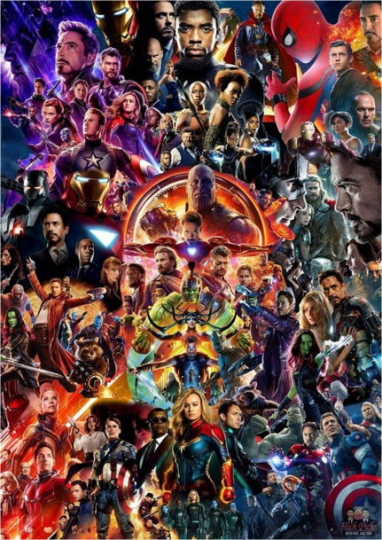
Cultural imperialism
Homogenization of culture
around the world under the
influence of the Global North.
• Do you agree or disagree
with Kincheloe: does fast food
have an ideological
dimension?
• If yes, what ideological
lessons are spread with the expansion of McDonalds’s into the Global South?

Slide 18
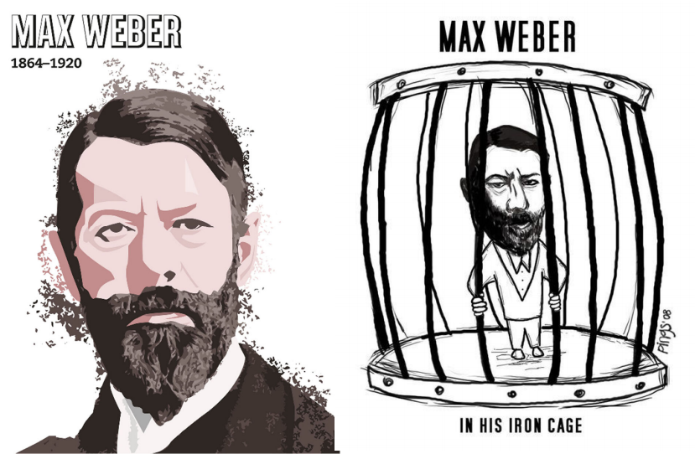

Slide 19
Iron cage
Weber: bureaucracy is a defining characteristic of modernity.
A hierarchical organizational form with set rules and procedures.
Form of rationalization.
Exists both in and outside governmental sector.
Iron cage: bureaucratic restrictions on individual agency, both of employees and clients.
• Is your university or college a bureaucratic institution? Why do you say so?
• If yes, what experiences of the “iron cage” have you had in your university life?
© 2017 Taylor & Francis

Slide 20


Slide 21
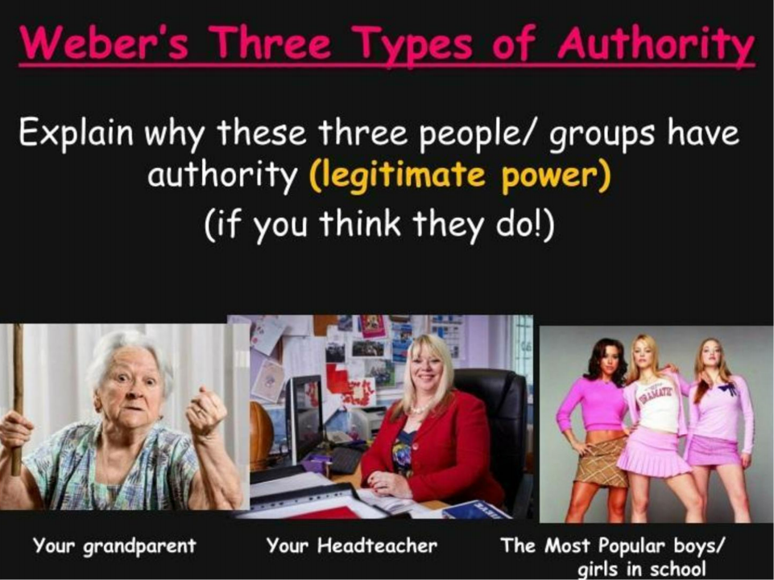

Slide 22
McDonaldization
Ritzer
A process whereby a wide variety of
social actors and institutions adopt organizational principles of fast food restaurants.
• What organizational principles of
McDonald’s or any other fast food chain you are familiar with?
© 2017 Taylor & Francis

Slide 23

Rotten Tomatoes' critical consensus reads, "The Founder puts Michael Keaton's magnetic performance at the center of a smart, satisfying biopic that traces the rise of one of America's most influential businessmen – and the birth of one of its most far-reaching industries."

Slide 24
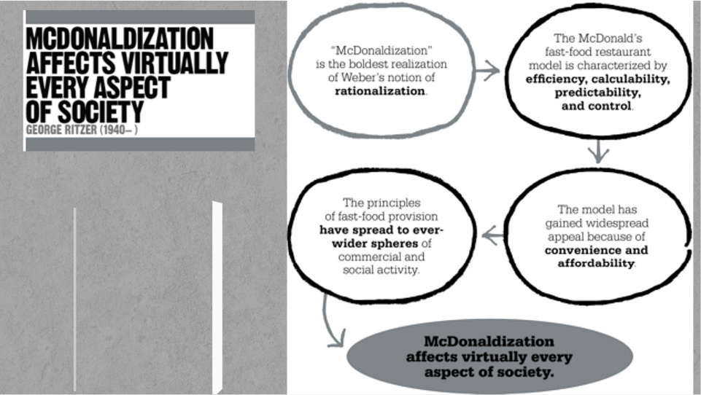
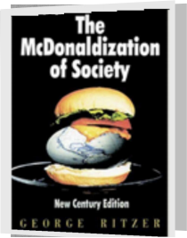
1993 The McDonaldization of Society: An
Investigation into the Changing Character of Social Life (George Ritzer)

Slide 25
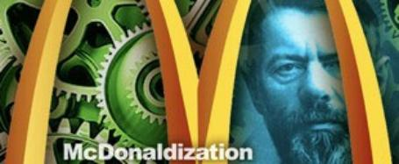
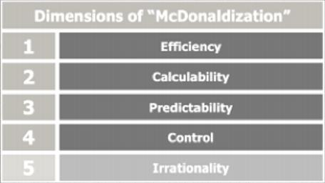
Principles of modernity
Echoing Weber’s notion of the “ iron cage,” Ritzer argues that
although McDonald’s has
assumed iconic status as a
highly efficient and profitable Western corporation, the
spread of its principles across an increasing number of
spheres of human activity leads to alienation.
©2017 Taylor &Francis

Slide 26
Features of McDonaldization
1. Efficiency: the fastest and most cost-effective means to a goal.
• How long would you wait in line to place an order in a fast-food restaurant?
• How often do you leave a fast-food restaurant without clearing your own table?
2. Calculability: measuring all aspects of the production process. Emphasis on speed increases work strain.
• Why are seats at McDonald’s uncomfortably hard and colors uncomfortably bright?
• A well-known Canadian pizza delivery chain advertises: “Thirty minutes or it’s free.”
• Why does it not advertise “Delicious or it’s free.”?
© 2017 Taylor & Francis

Slide 27
Features of McDonaldization (continued)
3. Predictability: consistency across time and place.
• You find yourself in Ho Chi Minh City at lunchtime. Will you have a banh mi at a sidewalk café or a burger at the local McDonald’s? Why?
4. Control over workers through technology and supervision.
• Effects: low labor costs, replacement of workers by technology.
• Why do all fast-food fryers have timers?
• Are you annoyed if a fast-food worker does not wish you to “have a nice day”?
© 2017 Taylor & Francis

Slide 28
Features of McDonaldization (continued)
5. Irrationality of rationality: efficient for whom?
• What is rational from the standpoint of fast-food industry may be irrational from the standpoint of workers,
customers, larger society, or the environment.
• Is fast food good for you? Why or why not?
• Why do you bus tables at McDonald’s when you are not paid to do so?
• Why is staff turnover at fast food restaurants high?
© 2017 Taylor & Francis

Slide 29
McDonald’s U?
In The McDonaldization of Higher Education, edited by Hayes and Wynyard(2002), sociologists explore how Ritzer’s theory
can be applied to the context of postsecondary
education.
Is your own college or university a McDonaldized institution? Working in groups,rate your school on a scale of 1–10 with regard to each of the four dimensions of
McDonaldization (i.e. efficiency, calculability, predictability, control). Come up with specific
examples that illustrate the degree to which this institution fits the characteristic in question
(Caronna 2010).

Slide 30

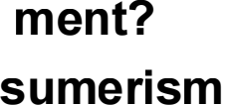
Solutions
oSocial Move
oEthical Con ?

Slide 31
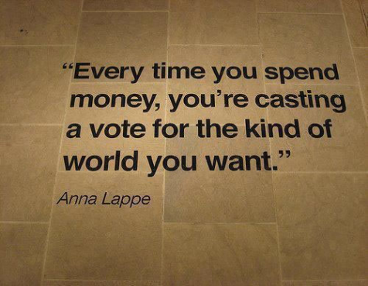
Ethical Consumerism
A type of consumer activism
that is based on the concept of dollar voting. It is practiced
through 'positive buying' in that ethical products are favored, or 'moral boycott', that is negative purchasing and company-based purchasing (Markus and Ela
2014).

Slide 32


Slide 33
Social movement
• A sustained, organized effort to achieve social change outside formal political channels.
• Vary in size (local to global) and goals (specific or general).
• Are you a member of a social movement? If not, would you like to join one? Why or why not?
• Is your favored social movement local or global? Are its goals specific or general?
• What kinds of social movements are most likely to succeed? Why?
© 2017 Taylor & Francis

Slide 34
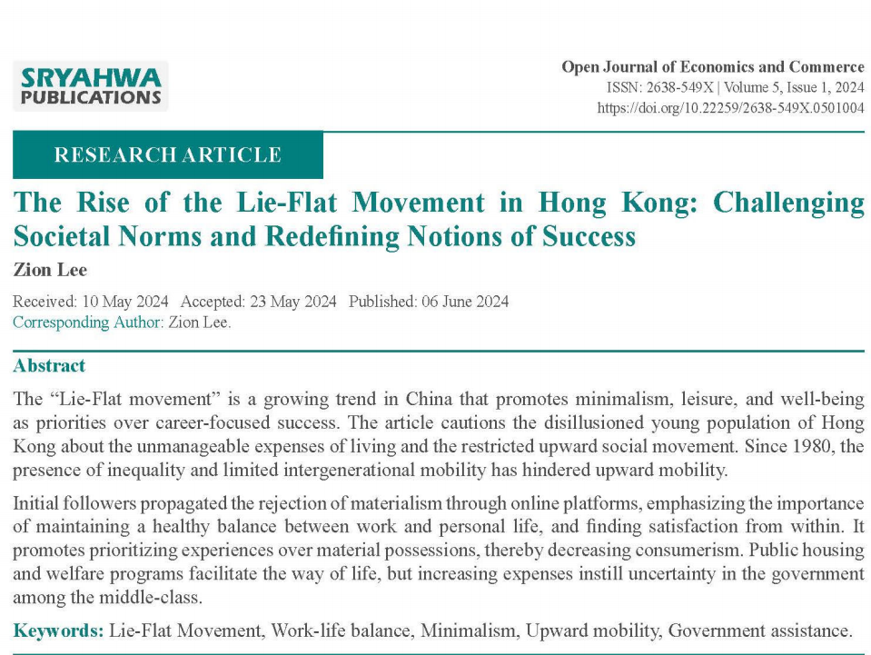

Slide 35
Explaining success of social movements
1. Resource mobilization: like any other organizations, social movements must mobilize people, money and
organizational capacity in order to be successful.
• Anarchist movement was much more popular in the USA in the 1920s than it is now. How would resource mobilization perspective explain
this change?
2. Political process model: social movements need
opportunities in order to succeed—openness of the
political system, and social-economic conditions that make the movement’s goal legitimate in the eyes of decision-
makers and the public.
• Anarchist movement was much more popular in the USA in the 1920s than it is now. How would political process model explain this change?
© 2017 Taylor & Francis

Slide 36
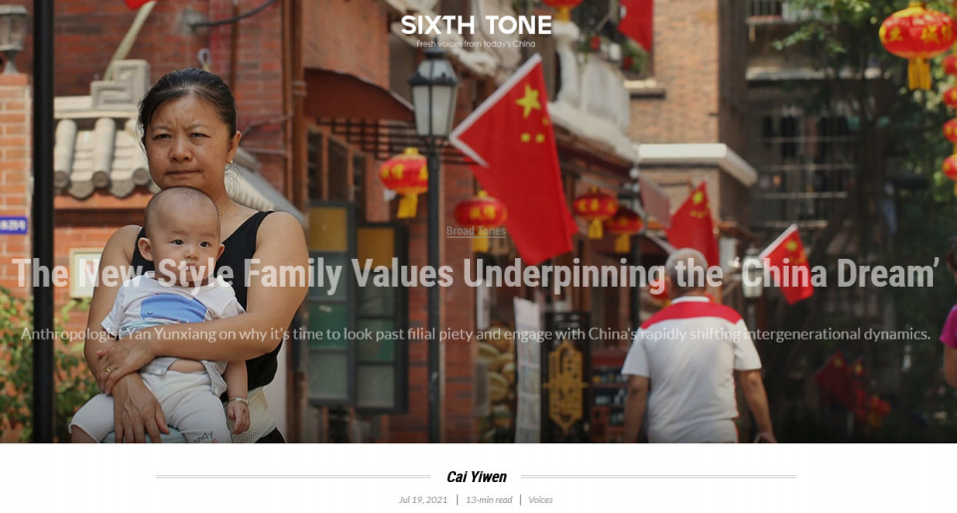
https://www.sixthtone.com/news/1007965/the-new-style-family-values-underpinning-the- china-dream

Slide 37
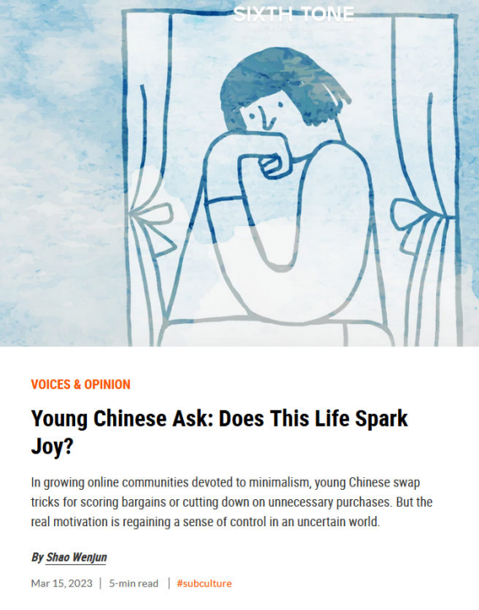
“In the West, social
movements and
consumption are both
viewed as important
means of self-expression; by comparison, many of the Chinese minimalists I interviewed said that,
while they hope their
families will respect their choices, they don’t want to impose them onto
others or affect other
people’s lives. Some don’t even want others to know about their lifestyles.”
https://www.sixthtone.com/news/1012459

Slide 38
Framing
To present ideas and information, emphasizing some aspects and minimizing others.
Goal: to promote a particular understanding. It influences legitimacy of a social movement.
• How does environmental movement frame the issue of “climate change”? How serious is the problem? What should be done to address it? Who is
responsible for it?
• Would calling it “global warming” change the answers to these questions?
© 2017 Taylor & Francis

Slide 39
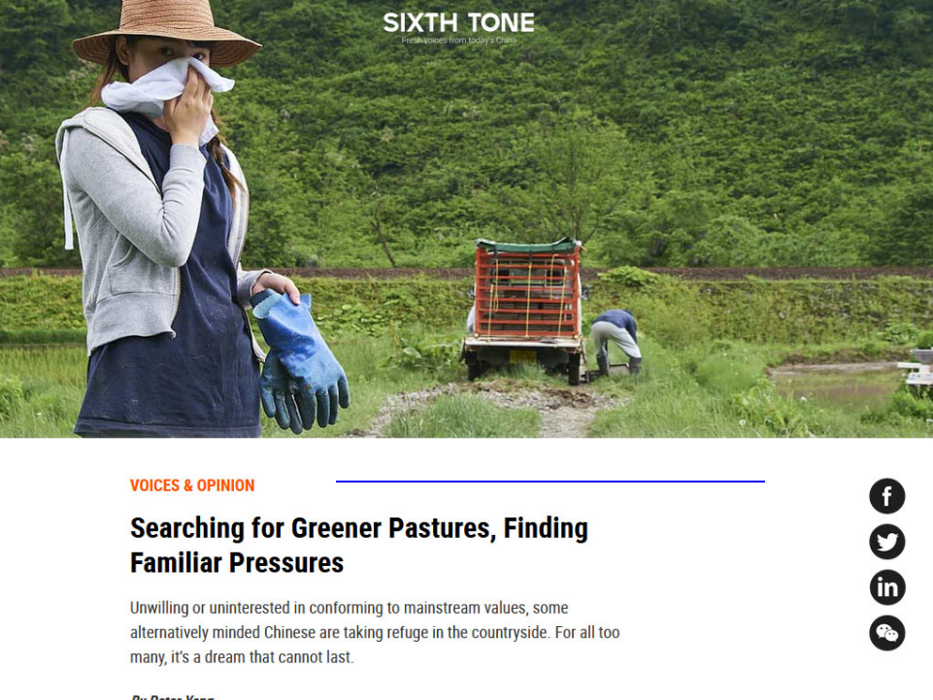
https://www.sixthtone.com/news/1005793

Slide 40
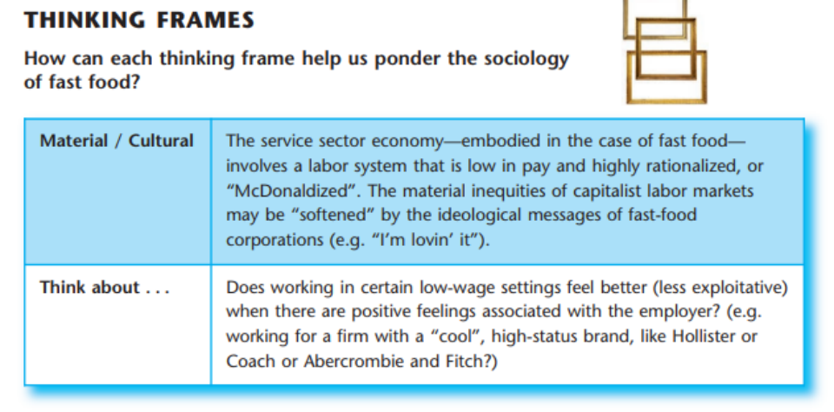

Slide 41
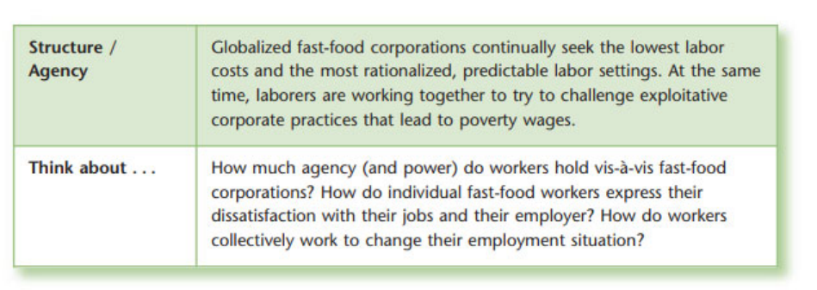

Slide 42
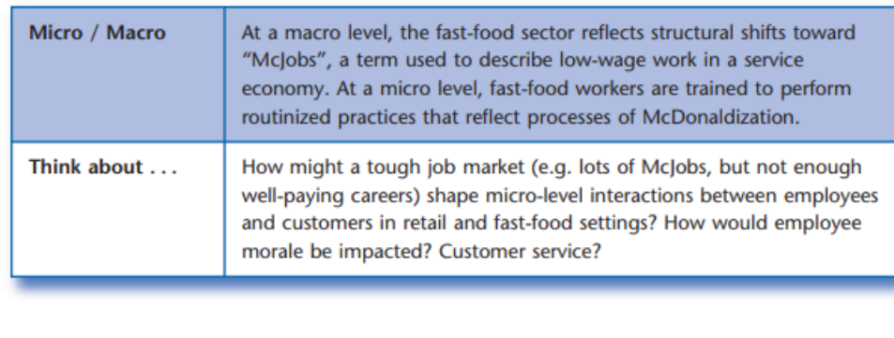

Slide 43
Research tool: ethnography
• The researcher is immersed in a social context for an extended period.
• Researcher observes and/or interacts with people.
• Goal: describe and interpret actions and experiences from an insider’s perspective.
• Micro: in-depth study of a small number of cases.
• Which phase in food production could you study using ethnographic method?
• How long would you stay in your research setting?
• What do you hope to describe and understand?
© 2017 Taylor & Francis

Slide 44



Central Sociology Perspective
An Ethnography Field Research was
conducted: an individual research on
Guozi sister and interview project from micro-perspective.
“Ethnographic research is a qualitative
research method used to study and
document the culture, behaviors, beliefs, and social interactions of a particular
group of people.”
Authors interpreted the case from a sociological perspective: l Lack of cultural capital l Alienation l Role loss
Possible missing perspective:
● Whole immigrants group
● Overall economic situation
● Imperfect government policy
121090651
120020428
121090417
122090211
122090783
k oc

